Slide 1


Muhammad Mubashir Mirza
April 17, 2023.

Slide 2

Outline
Executive Summary
Introduction
Methodology
Results
Conclusion
Appendix

Slide 3
Executive Summary
Summary of methodologies
Summary of all results

Slide 4
Introduction
Project background and context
Problems you want to find answers

Slide 5

Section 1

Slide 6
Methodology
Executive Summary
Data collection methodology:
The data is collected by scraping the SpaceX wiki page.
Perform data wrangling
The data is processedby removing unnecessary details, normalization and standardization.
Perform exploratory data analysis (EDA) using visualization and SQL
Perform interactive visual analytics using Folium and Plotly Dash
Perform predictive analysis using classification models
Classification models are build using Logistic regression, KNN and SVM and Decision Trees. Their best parameters are calculated by Grid Search. Their results are evaluated by F1 Score and Confusion Matrix.

Slide 7
Data Collection
Describe how data sets were collected.
You need to present your data collection process use key phrases and flowcharts

Slide 8
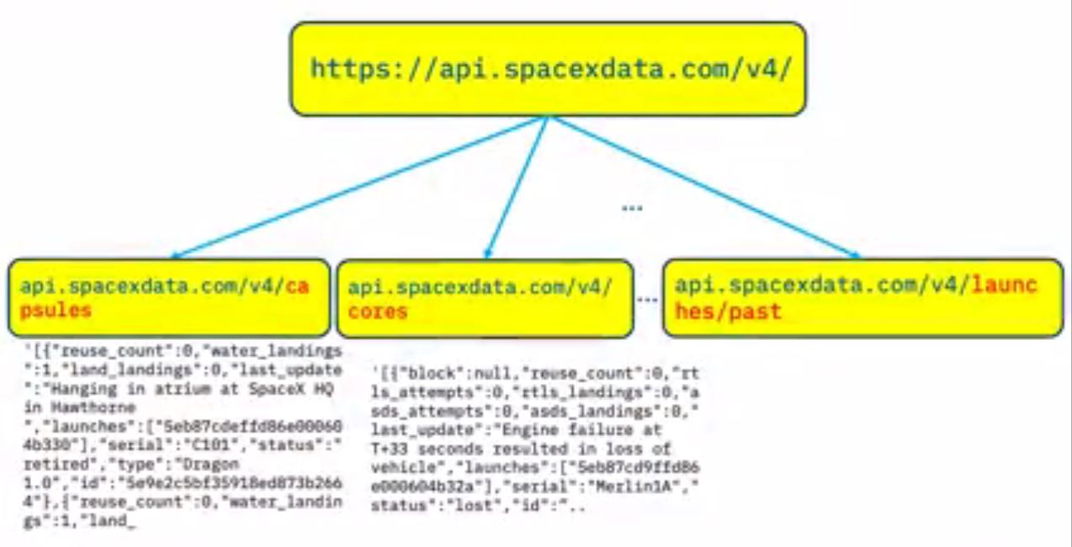
Data Collection – SpaceX API
https://github.com/Mirza-Algo/DataScienceProjects/blob/main/Data%20Collection.ipynb

Slide 9
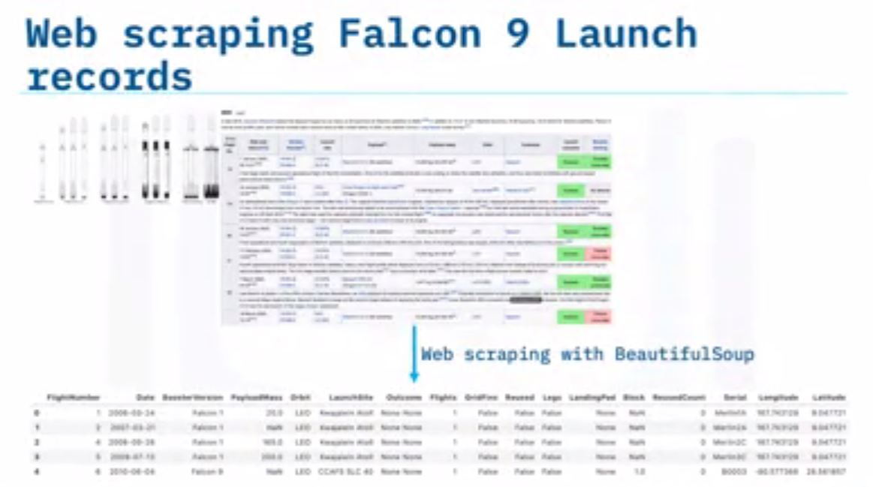
Data Collection - Scraping
Present your web scraping process using key phrases and flowcharts
Add the GitHub URL of the completed web scraping notebook, as an external reference and peer-review purpose
https://github.com/Mirza-Algo/DataScienceProjects/blob/main/WebScraping.ipynb

Slide 10
Data Wrangling
https://github.com/Mirza-Algo/DataScienceProjects/blob/main/Data%20Wrangling.ipynb

Slide 11
EDA with Data Visualization
https://github.com/Mirza-Algo/DataScienceProjects/blob/main/Data%20Visualization.ipynb

Slide 12
EDA with SQL
https://github.com/Mirza-Algo/DataScienceProjects/blob/main/SQL%20EDA.ipynb

Slide 13
Build an Interactive Map with Folium
https://github.com/Mirza-Algo/DataScienceProjects/blob/main/2.%20Folium%20Maps.ipynb

Slide 14
Build a Dashboard with Plotly Dash
https://github.com/Mirza-Algo/DataScienceProjects/blob/main/3.%20Interactive%20Dashboard.ipynb

Slide 15
Predictive Analysis (Classification)
https://github.com/Mirza-Algo/DataScienceProjects/blob/main/SpaceX_Machine_Learning_Prediction.ipynb

Slide 16
Results
Exploratory data analysis results
Interactive analytics demo in screenshots
Predictive analysis results

Slide 17

Section 2

Slide 18
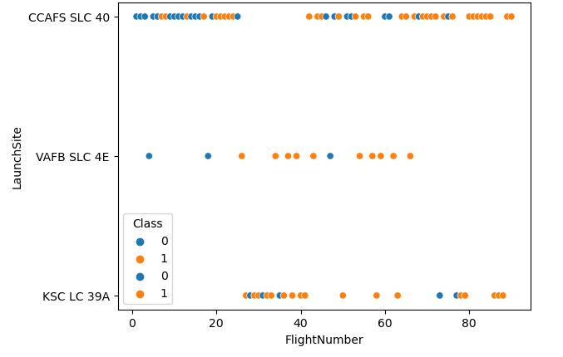
Flight Number vs. Launch Site
Scatter plot of Flight Number vs. Launch Site

Slide 19
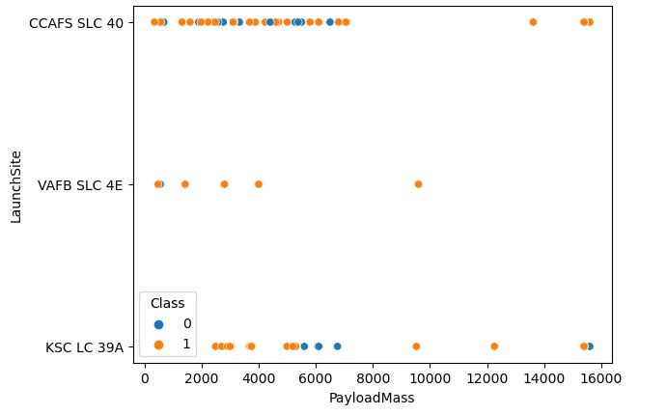
Payload vs. Launch Site
Scatter plot of Payload vs. Launch Site

Slide 20
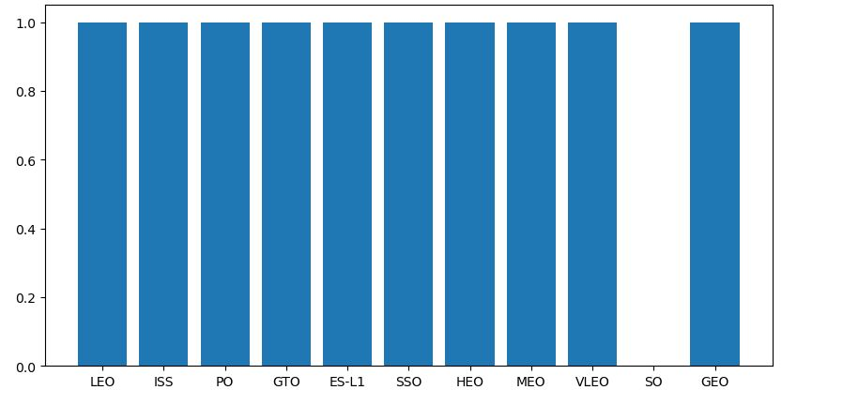
Success Rate vs. Orbit Type
Bar chart for the success rate of each orbit type

Slide 21
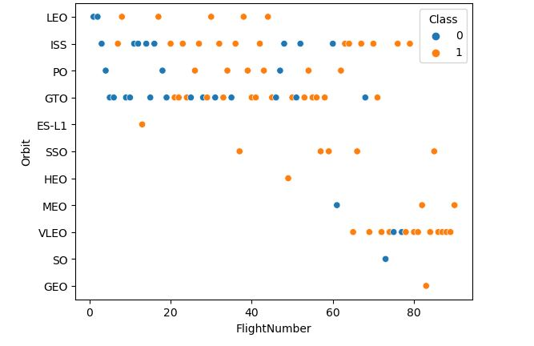
Flight Number vs. Orbit Type
Scatter point of Flight number vs. Orbit type

Slide 22
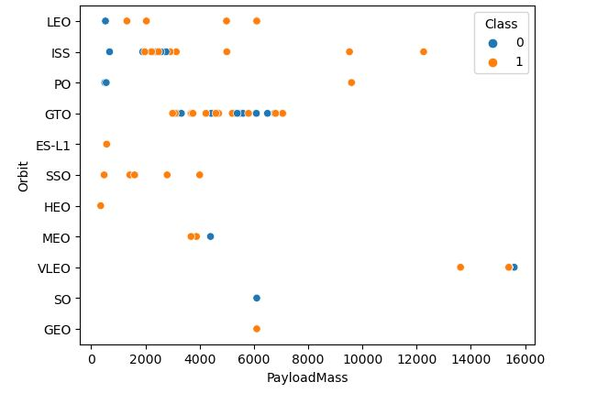
Payload vs. Orbit Type
Scatter point of payload vs. orbit type

Slide 23
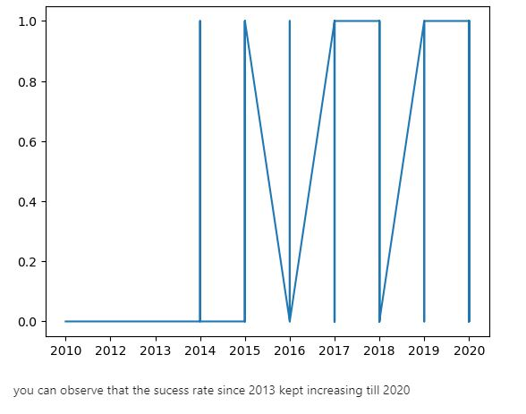
Launch Success Yearly Trend
Line chart of yearly average success rate

Slide 24
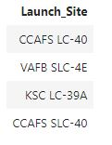
All Launch Site Names
Names of the unique launch sites.

Slide 25
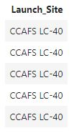
Launch Site Names Begin with 'CCA'
5 records where launch sites begin with `CCA`.

Slide 26
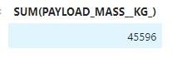
Total Payload Mass
Total payload carried by boosters from NASA.

Slide 27
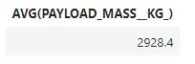
Average Payload Mass by F9 v1.1
Average payload mass carried by booster version F9 v1.1.

Slide 28
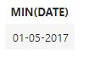
First Successful Ground Landing Date
Date of the first successful landing outcome on ground pad.

Slide 29
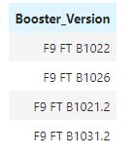
Successful Drone Ship Landing with Payload between 4000 and 6000
List of the names of boosters which have successfully landed on drone ship and had payload mass greater than 4000 but less than 6000

Slide 30
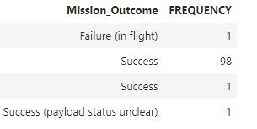
Total Number of Successful and Failure Mission Outcomes
Calculate the total number of successful and failure mission outcome.

Slide 31
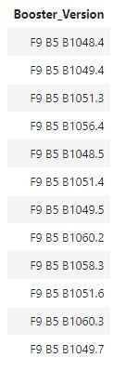
Boosters Carried Maximum Payload
List of the names of the booster which have carried the maximum payload mass.

Slide 32
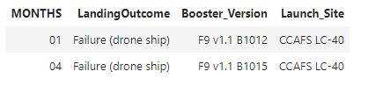
2015 Launch Records
List of the failed landing_outcomes in drone ship, their booster versions, and launch site names for in year 2015.

Slide 33
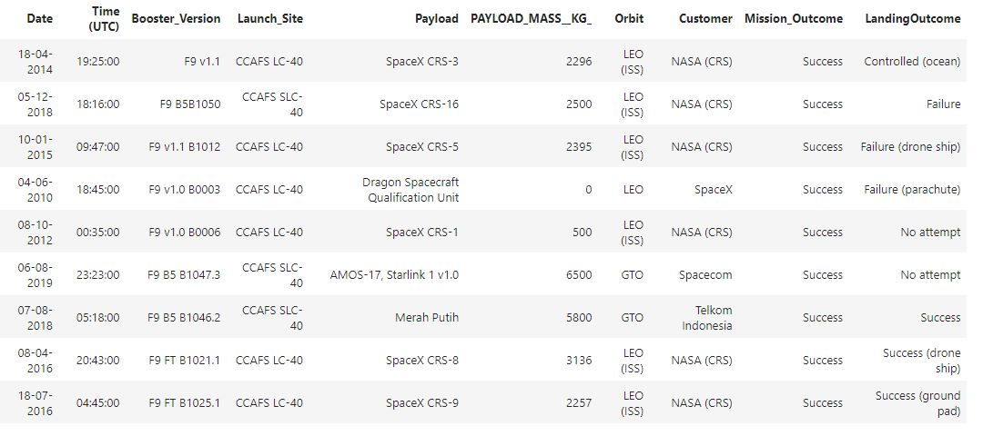
Rank Landing Outcomes Between 2010-06-04 and 2017-03-20
Rank the count of landing outcomes (such as Failure (drone ship) or Success (ground pad)) between the date 2010-06-04 and 2017-03-20, in descending order

Slide 34

Section 3

Slide 35
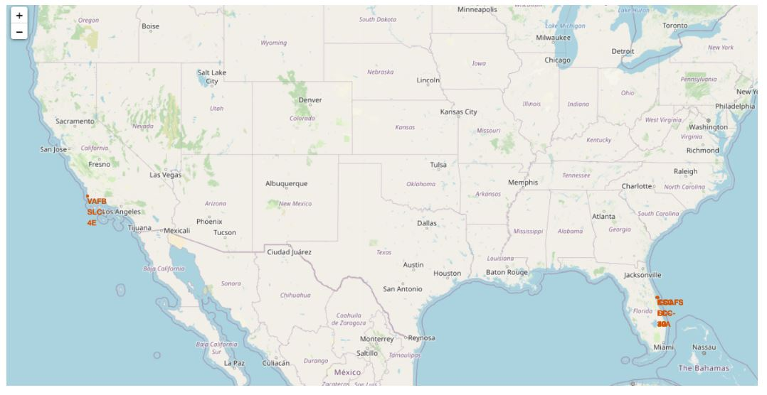
Launch Sites on the Map

Slide 36
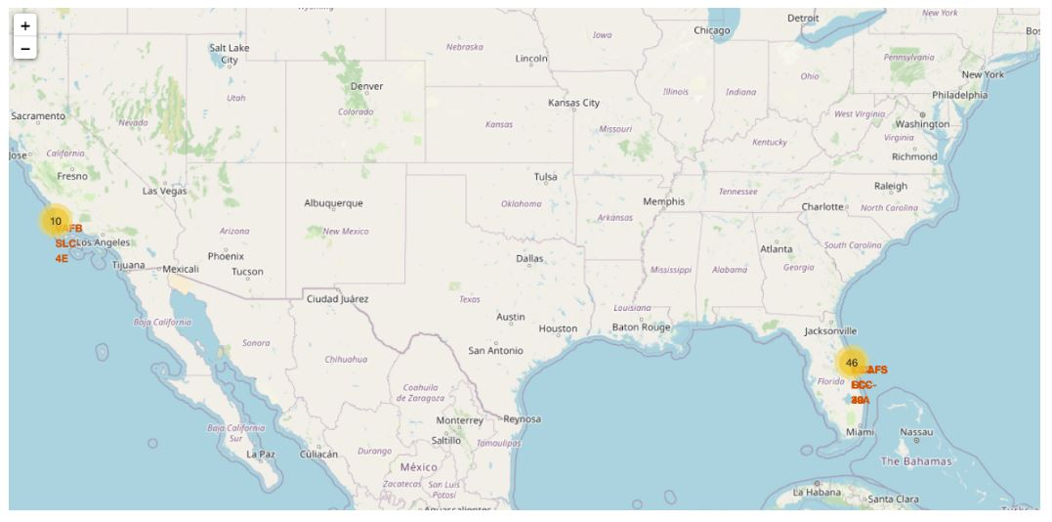
Color Labeled Launch Outcomes

Slide 37
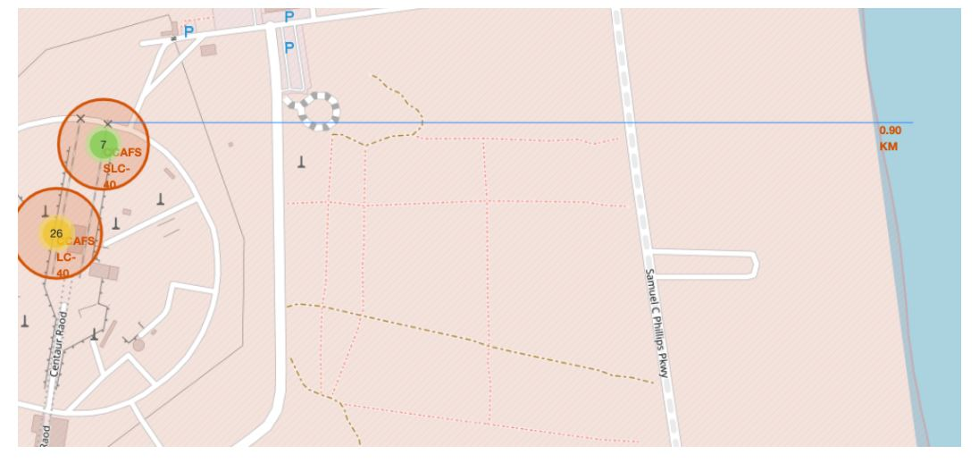
Launch Sites Proximities

Slide 38

Section 4

Slide 39
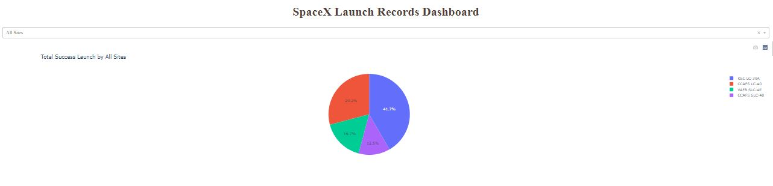
Total Success Launch by All Sites

Slide 40
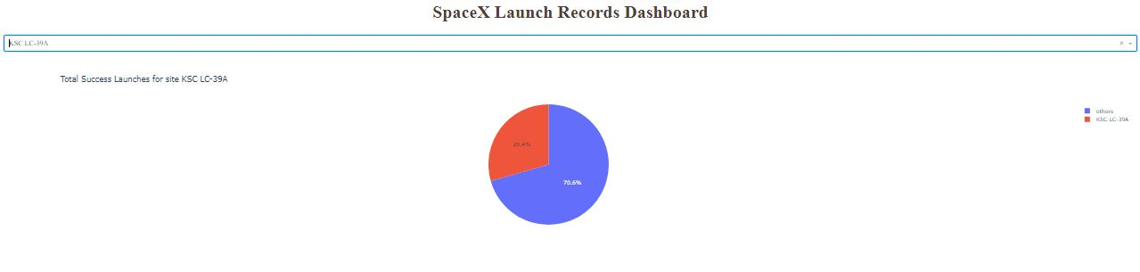
Launch Site with the highest rate

Slide 41
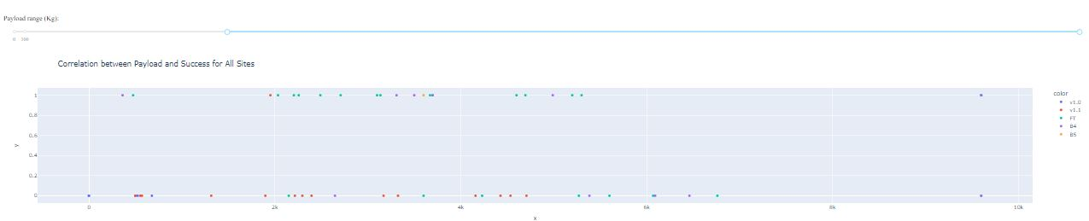
Payload vs Launch Outcome Scatter Plot

Slide 42

Section 5

Slide 43
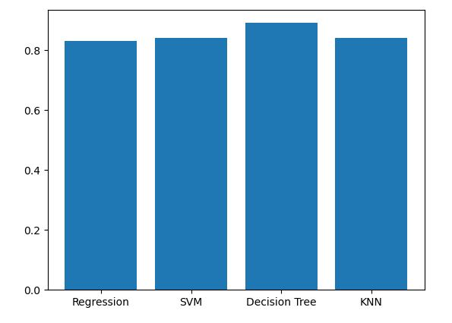
Classification Accuracy

Slide 44
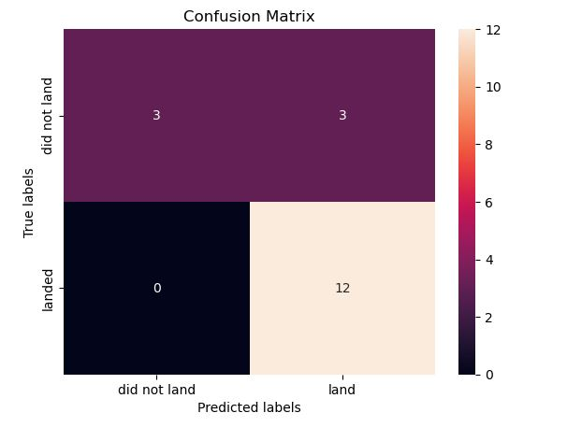
Confusion Matrix

Slide 45
Conclusions
Point 1
Point 2
Point 3
Point 4
…

Slide 46
Appendix
Include any relevant assets like Python code snippets, SQL queries, charts, Notebook outputs, or data sets that you may have created during this project
Notes:
https://github.com/Mirza-Algo/DataScienceProjects

Slide 47


